Slide 1
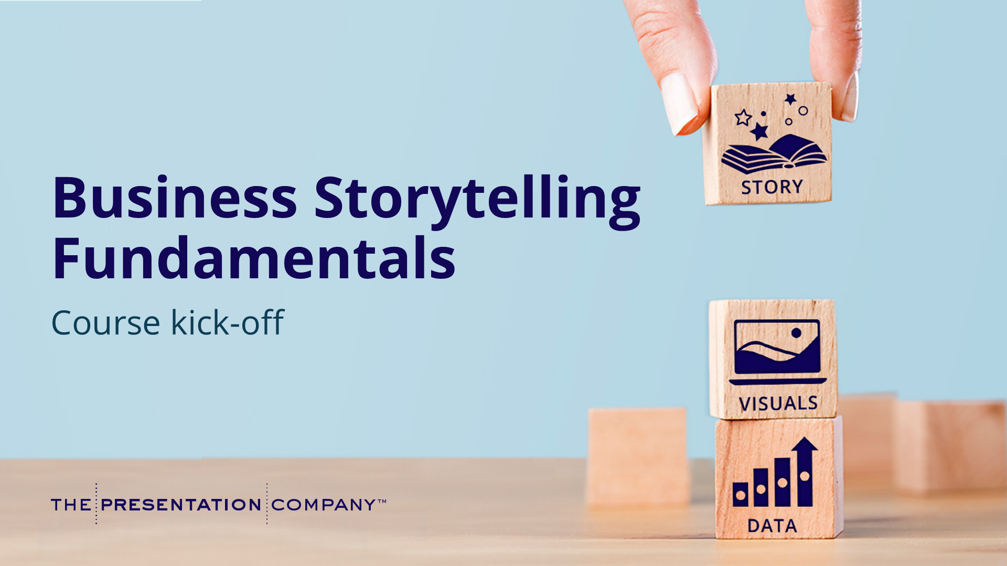
Notes:
Welcome! Thank you for joining – we are excited to kick-off a new training opportunity we’ve partnered with The Presentation Company on.
Business Storytelling Fundamentals is a self-paced, online course that you can complete in about one hour.
And today we want to provide a quick preview so you know what to expect and how to make the most of your learning experience.
[TRANSITION]: Before we begin, I want to set the scene…

Slide 2
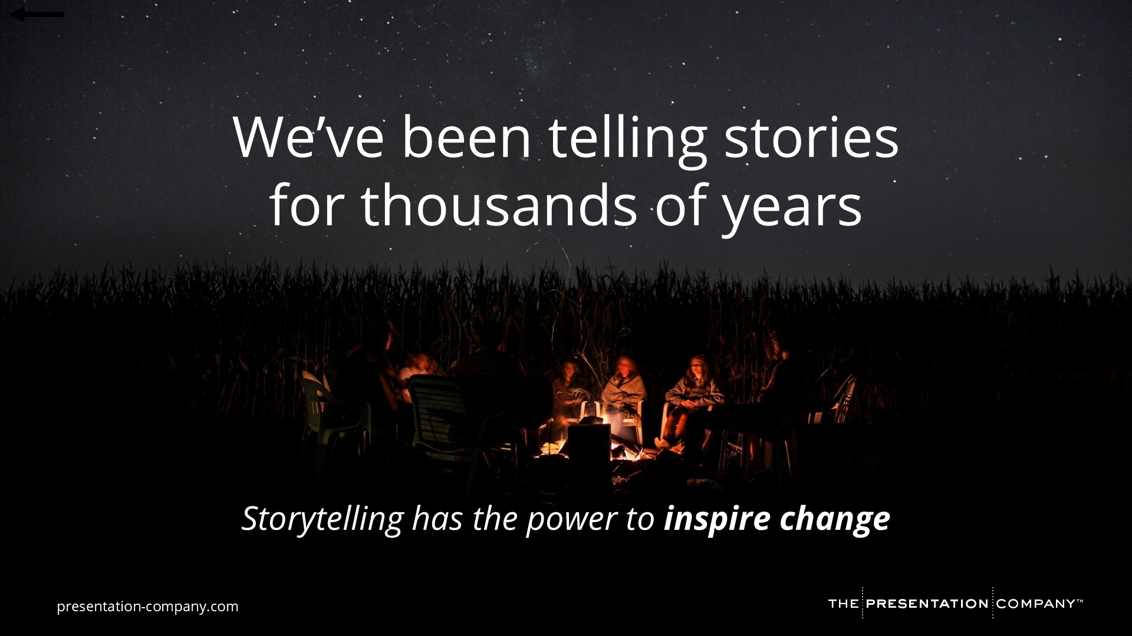
Notes:
As you know, we’ve been telling stories for thousands of years.
It’s part of our DNA as humans!
Storytelling has the power to inspire change, which is why we’ve we have chosen to work with TPC.
We believe that you’re already great at what you do and once you harness the power of business storytelling, you’ll be unstoppable!
[NOTE FOR CLIENT SPONSOR: This is a great place for you to narrate the connection between your corporate goals and TPC’s work. You might say something like]:
We’ve selected TPC as a partner because they have created a simple and repeatable framework for creating business narratives.
As you know, at [COMPANY NAME] we are on a mission to [INSERT COMPANY INITIATIVE] and stories play an integral role in helping us accomplish this goal.
[TRANSITION]: And, we’re not alone in this pursuit…

Slide 3
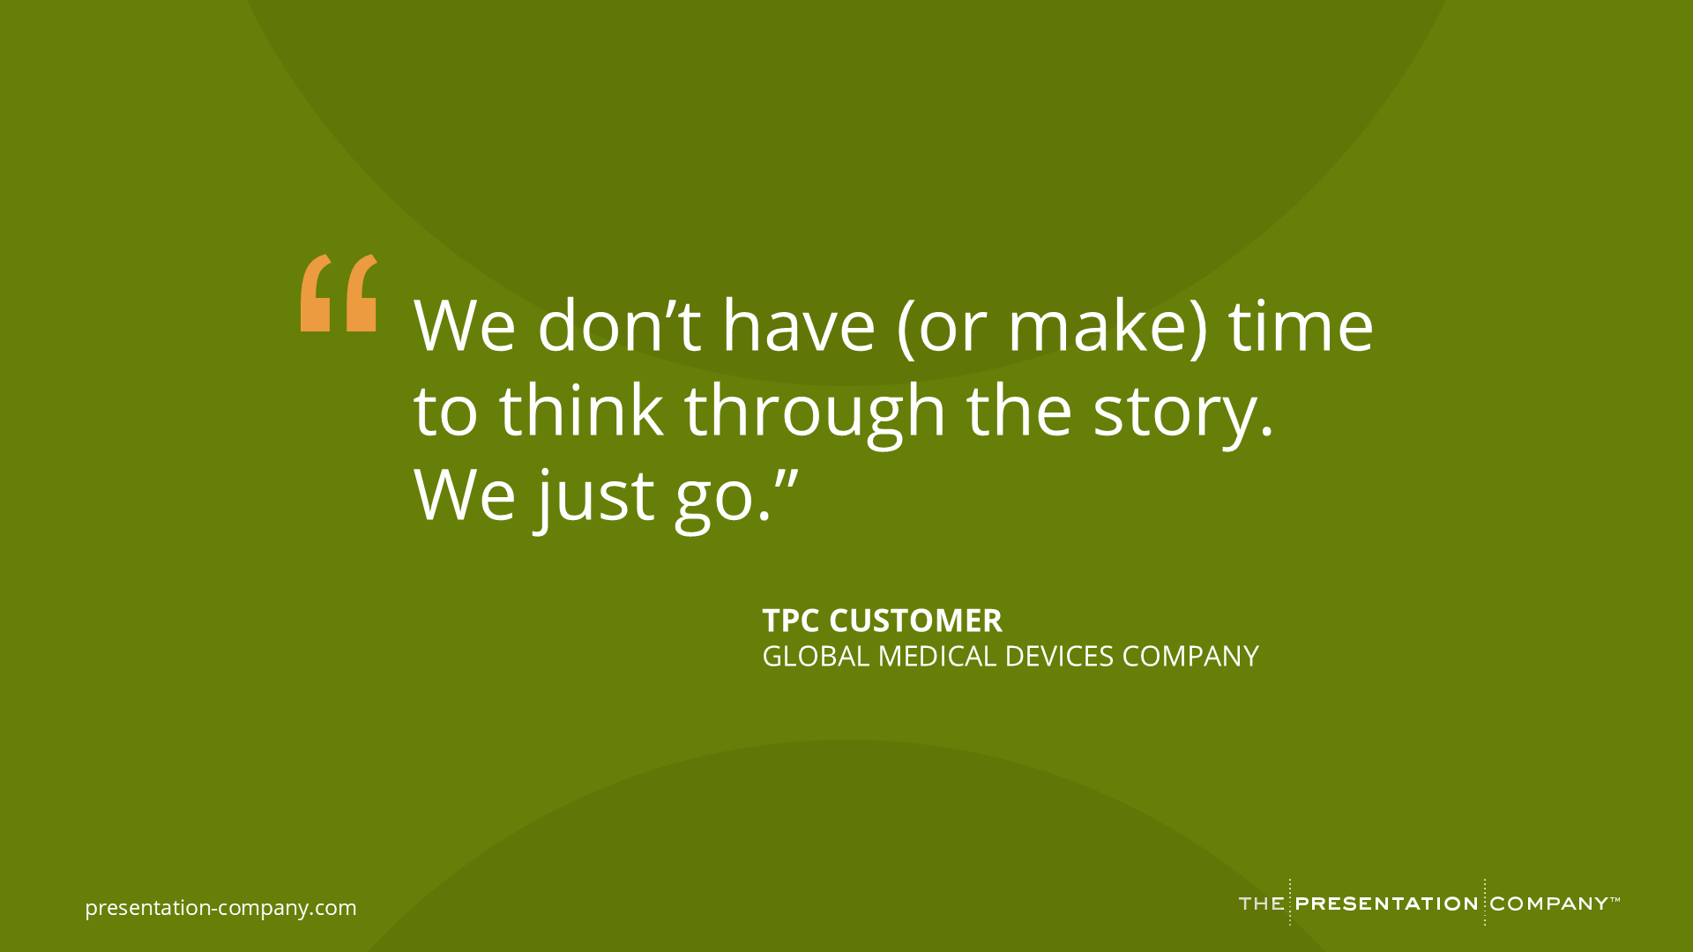
Notes:
…We’re not alone in this pursuit.
I want to share this quote from a TPC customer.
[Read quote]
[Ask]: When was the last time you dedicated meaningful time to crafting a business story?
[Create interaction]: I’d love to hear from you in the chat. How does this quote resonate with you?
[TRANSITION]: Let’s look at another quote…

Slide 4
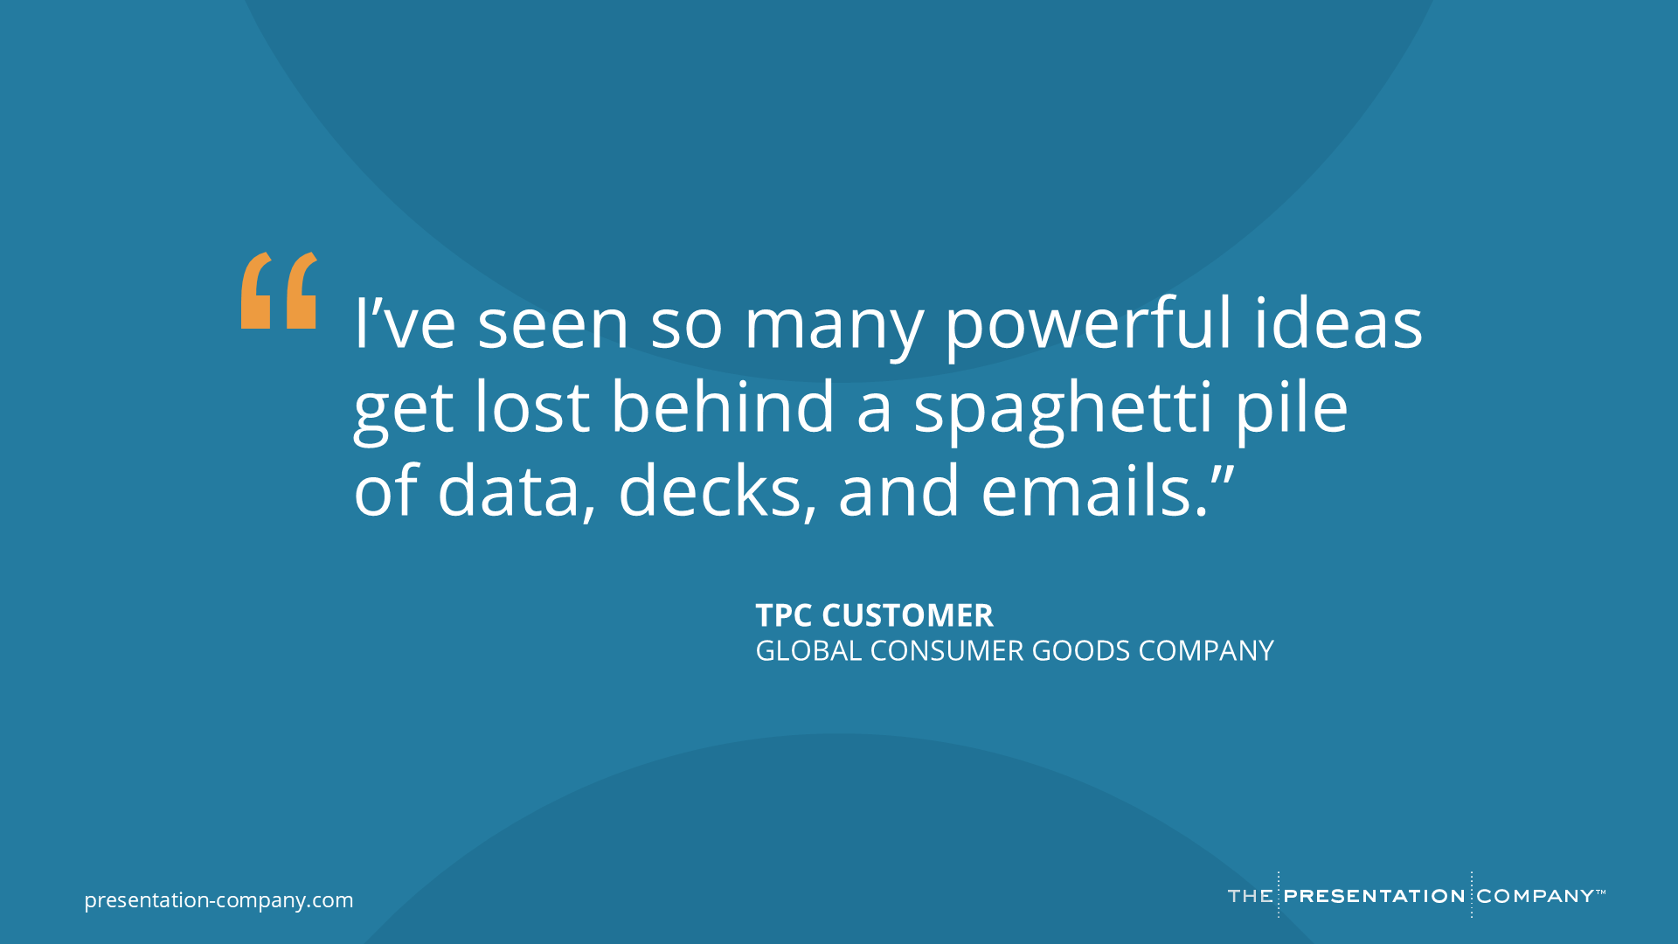
Notes:
[Read quote]
[Group discussion]: What does data look like in your decks? Give me some feedback in the chat or come off mute and help me/us understand your challenges with presenting data.
[TRANSITION]: One more question for you…

Slide 5
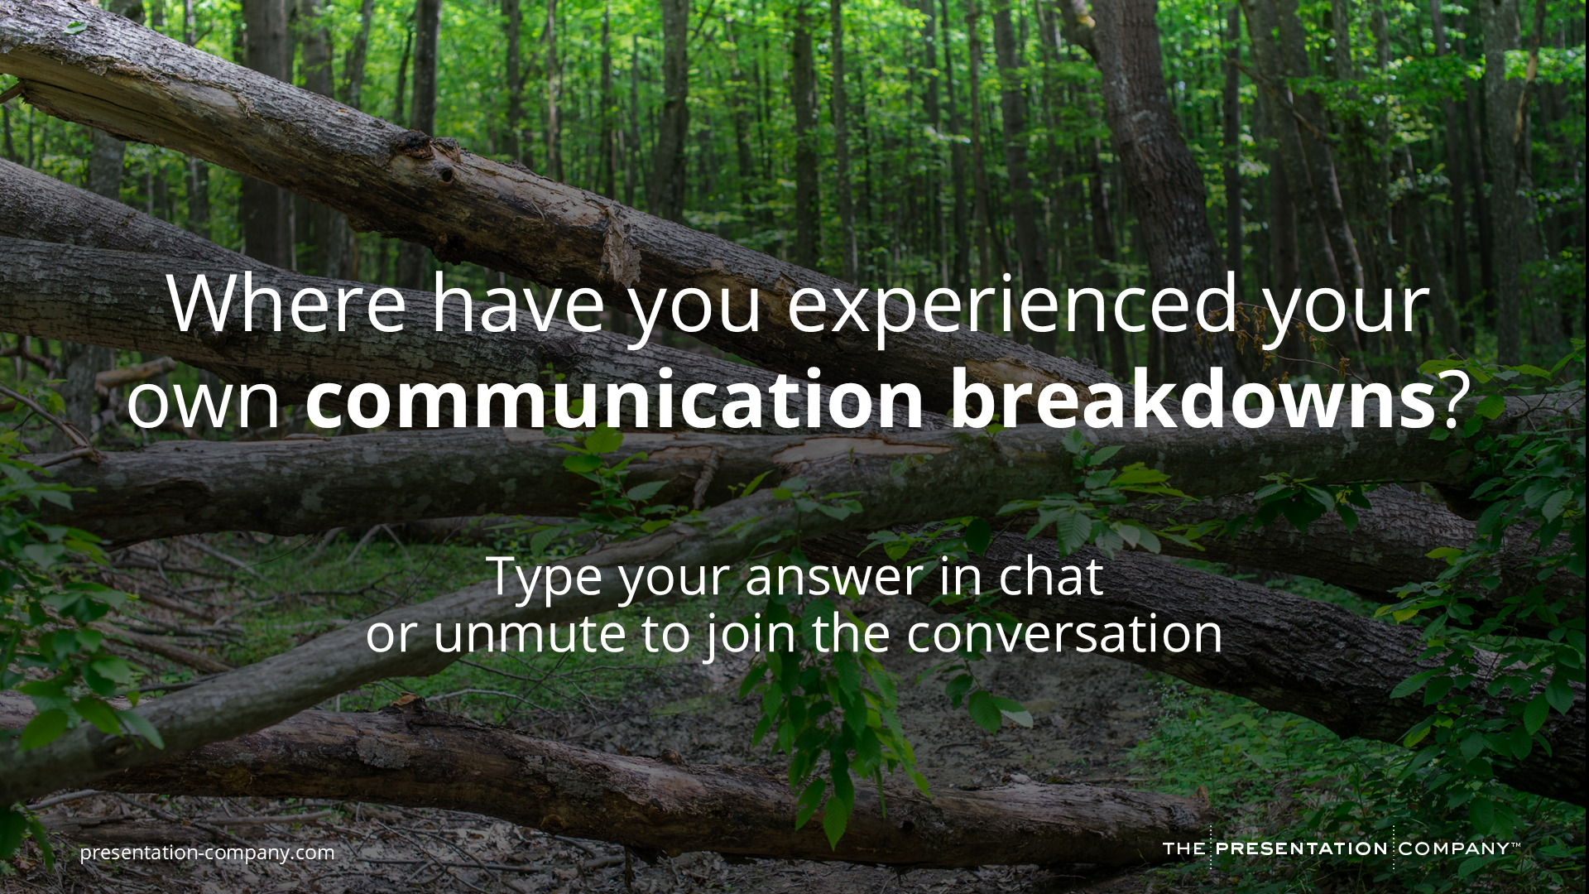
Notes:
Where have you experienced your own communication breakdowns?
Go ahead and type your answer in Chat or unmute to join the conversation!
[Take a few responses]
[TRANSITION]: Thanks for sharing. The truth is…

Slide 6
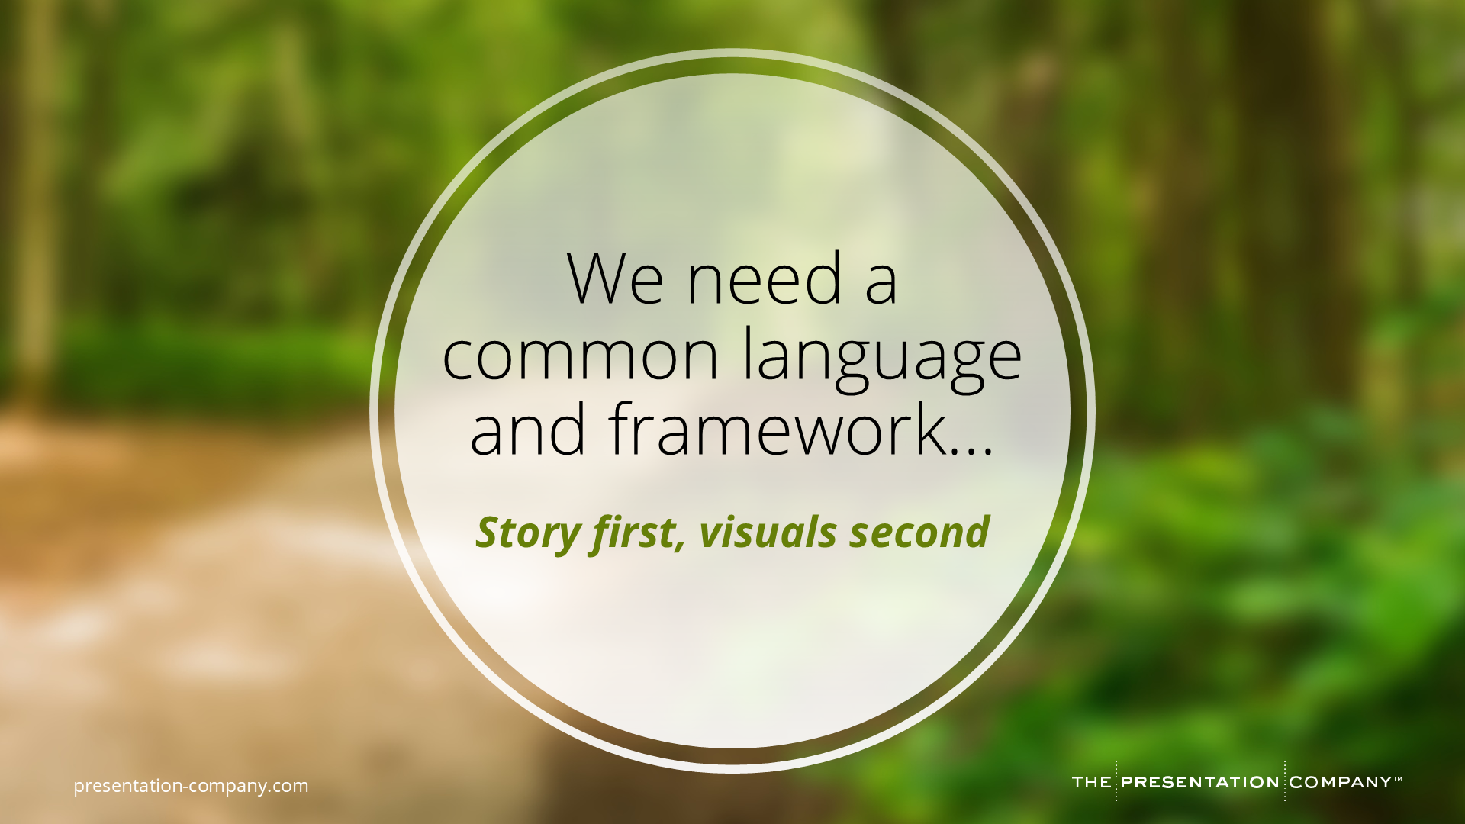
Notes:
The best communicators – and teams – need a COMMON LANGUAGE and FRAMEWORK… that is grounded in a STORY FIRST, VISUALS SECOND mindset.​
Most of us start with the “pretty” (the templates we have been given, slides we have been told to include). ​
But we end up with what TPC calls Frankendecks… cobbled together ideas and data that lack a cohesive narrative or visual strategy.​
This DOES NOT help us make decisions quickly.
In fact, it stalls it and we miss an opportunity to INFLUENCE DECISIONS and DRIVE BUSINESS FORWARD. ​
​
[TRANSITION]:​ And just as important, the best stories are…

Slide 7
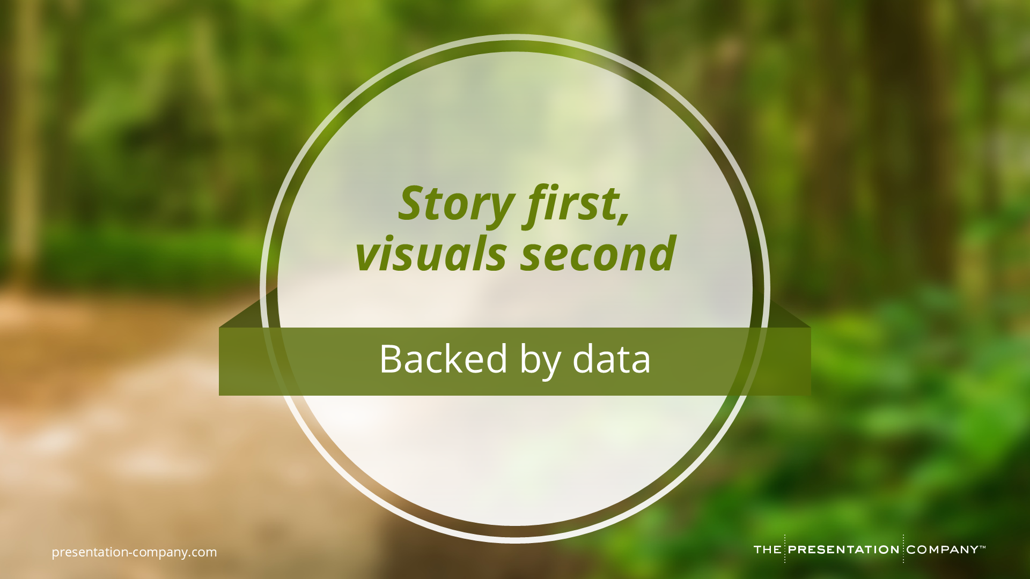
Notes:
…backed by data. Data helps bolster our decision-making.
However, it’s critical we understand:
Where the data should live in the context of our story
How to bring it to life visually
And the best ways to build data visualizations for impact
[TRANSITION]: And that’s because…

Slide 8
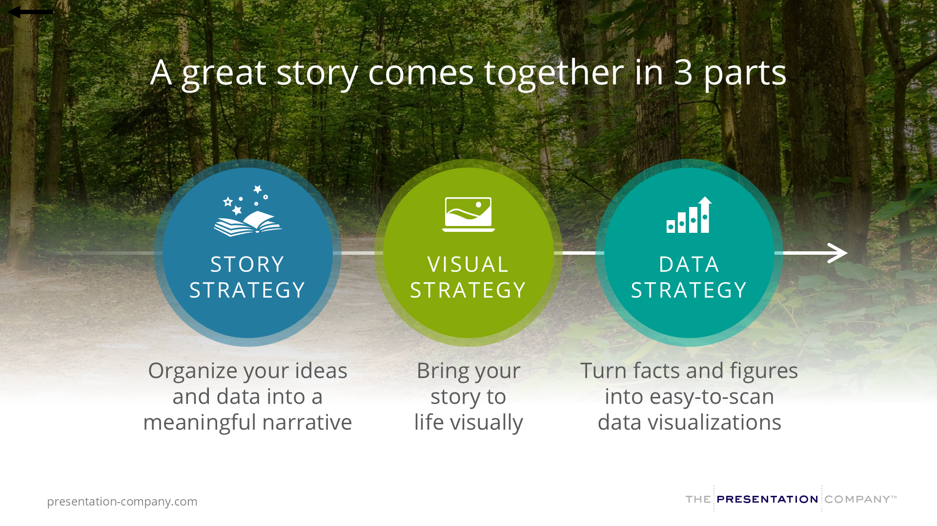
Notes:
A great story comes together in 3 parts.
We need a…
STORY STRATEGY to help organize our ideas and data into a meaningful narrative.
VISUAL STRATEGY to bring our story to life visually.
DATA STRATEGY to turn facts and figures into easy-to-scan data visualizations.
Each of these elements on their own is powerful, but when combined, they become EXPONENTIALLY POWERFUL.
[TRANSITION]: And that’s where Business Storytelling Fundamentals comes in…

Slide 9
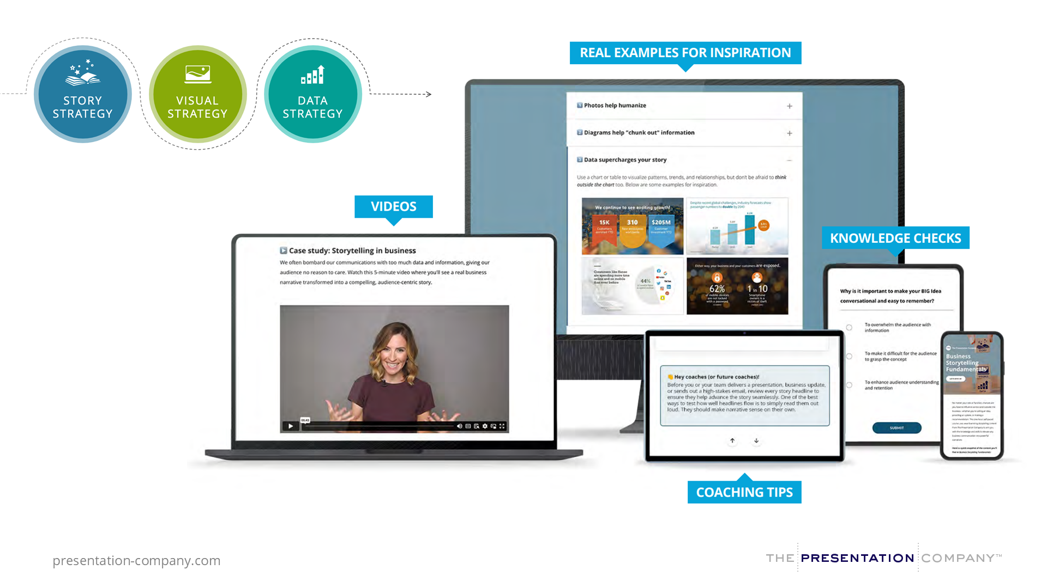
Notes:
During this one-hour course, you’ll:
Watch short videos that arm you with strategies for building your story, visualizing it, and bolstering it with data
See real business examples for inspiration
Complete knowledge checks along the way
And get coaching tips throughout so you and your colleagues can speak the same storytelling language moving forward.
[TRANSITION]: Let’s get a sneak peek at what you’ll be learning…

Slide 10
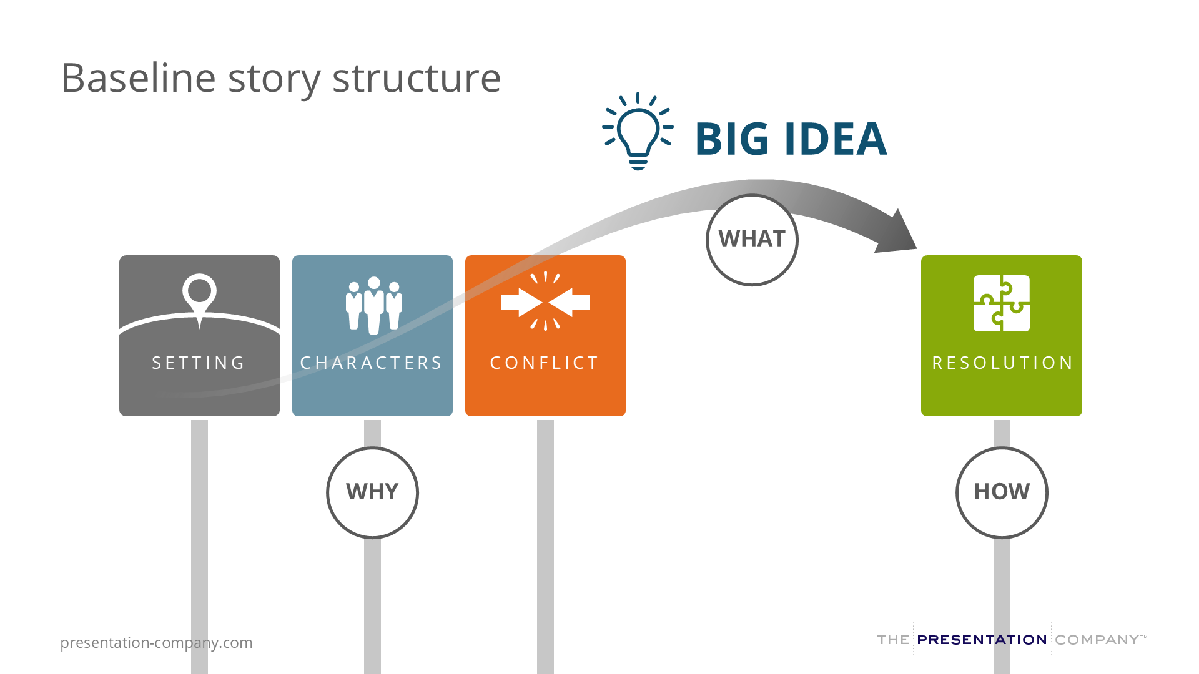
Notes:
You’re going to get introduced to a simple, practical, and repeatable framework.
It explores the WHY, WHAT and HOW of BUSINESS storytelling.
Spoiler alert: Most of us start with the HOW, the Resolution of our story (our products, our solutions)
When we should really be starting with the WHY (context for why our audience should care).
And the WHAT (the BIG Idea), glues this all together – it’s the ONE thing we want our audience to remember.

Slide 11
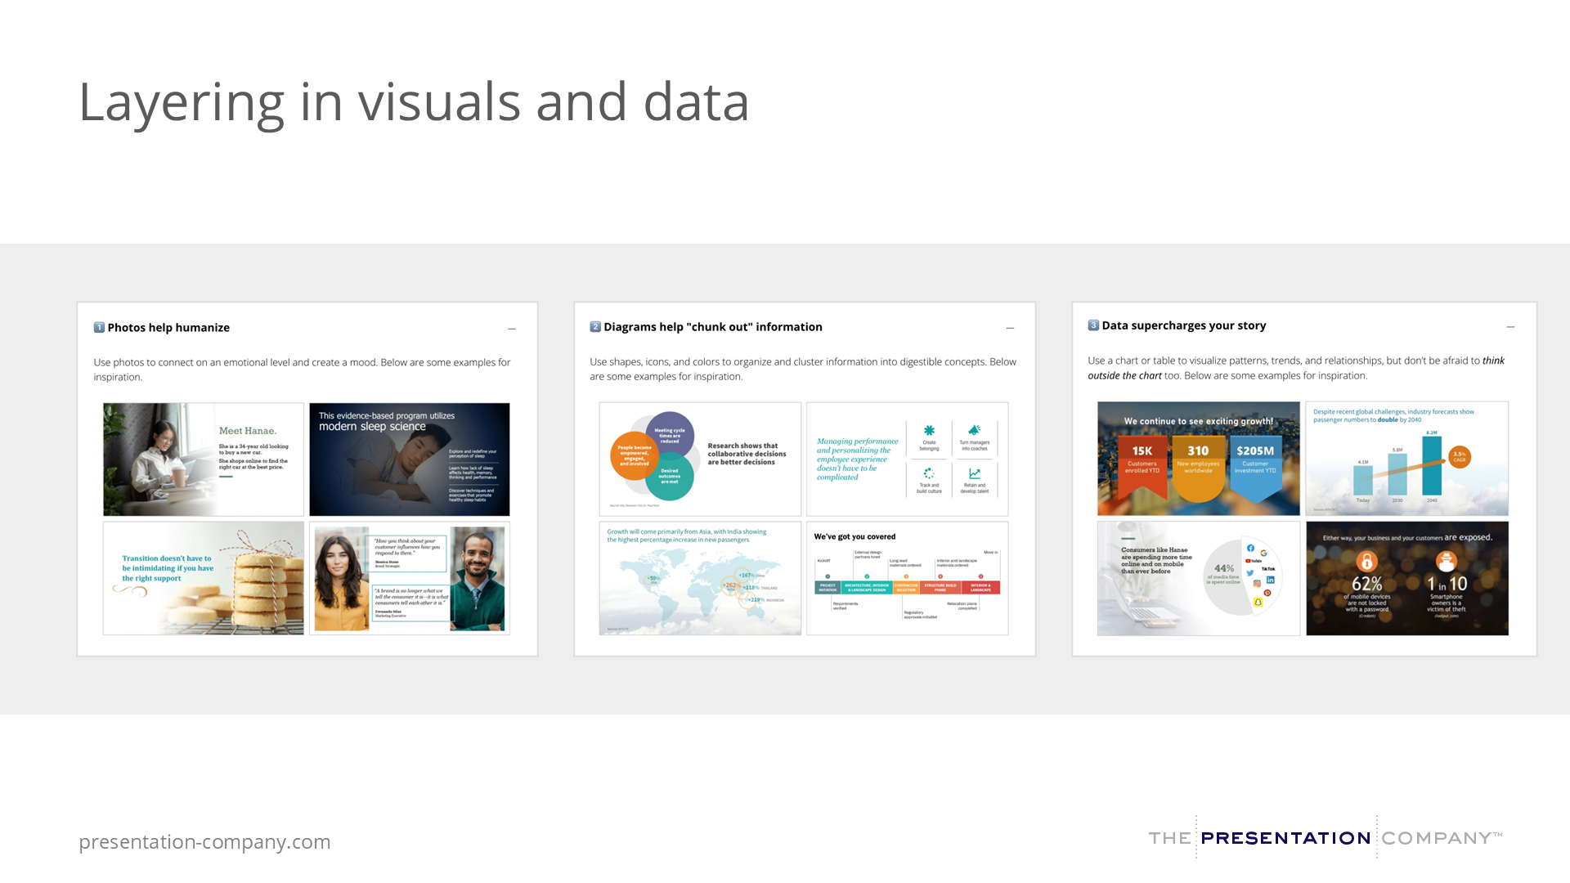
Notes:
Once you understand the baseline story structure, the course will layer in tips for how to use visuals and data in a way that helps your audience quickly and easily scan your communications and understand key insights.
[TRANSITION]: So, what does this look like in the online class?

Slide 12
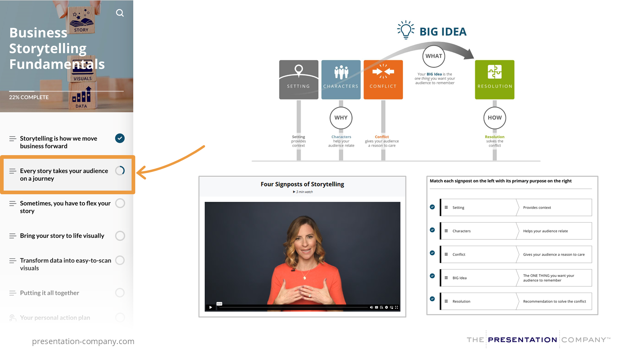
Notes:
On the left navigation bar (once you login), look on the left for each module and to track your progress.
You can see that concepts from the course build on one another.
Once you learn about storytelling, visuals, and data, you can put it all together with a personal action plan.
Or, download a companion guide to easily reference concepts.

Slide 13
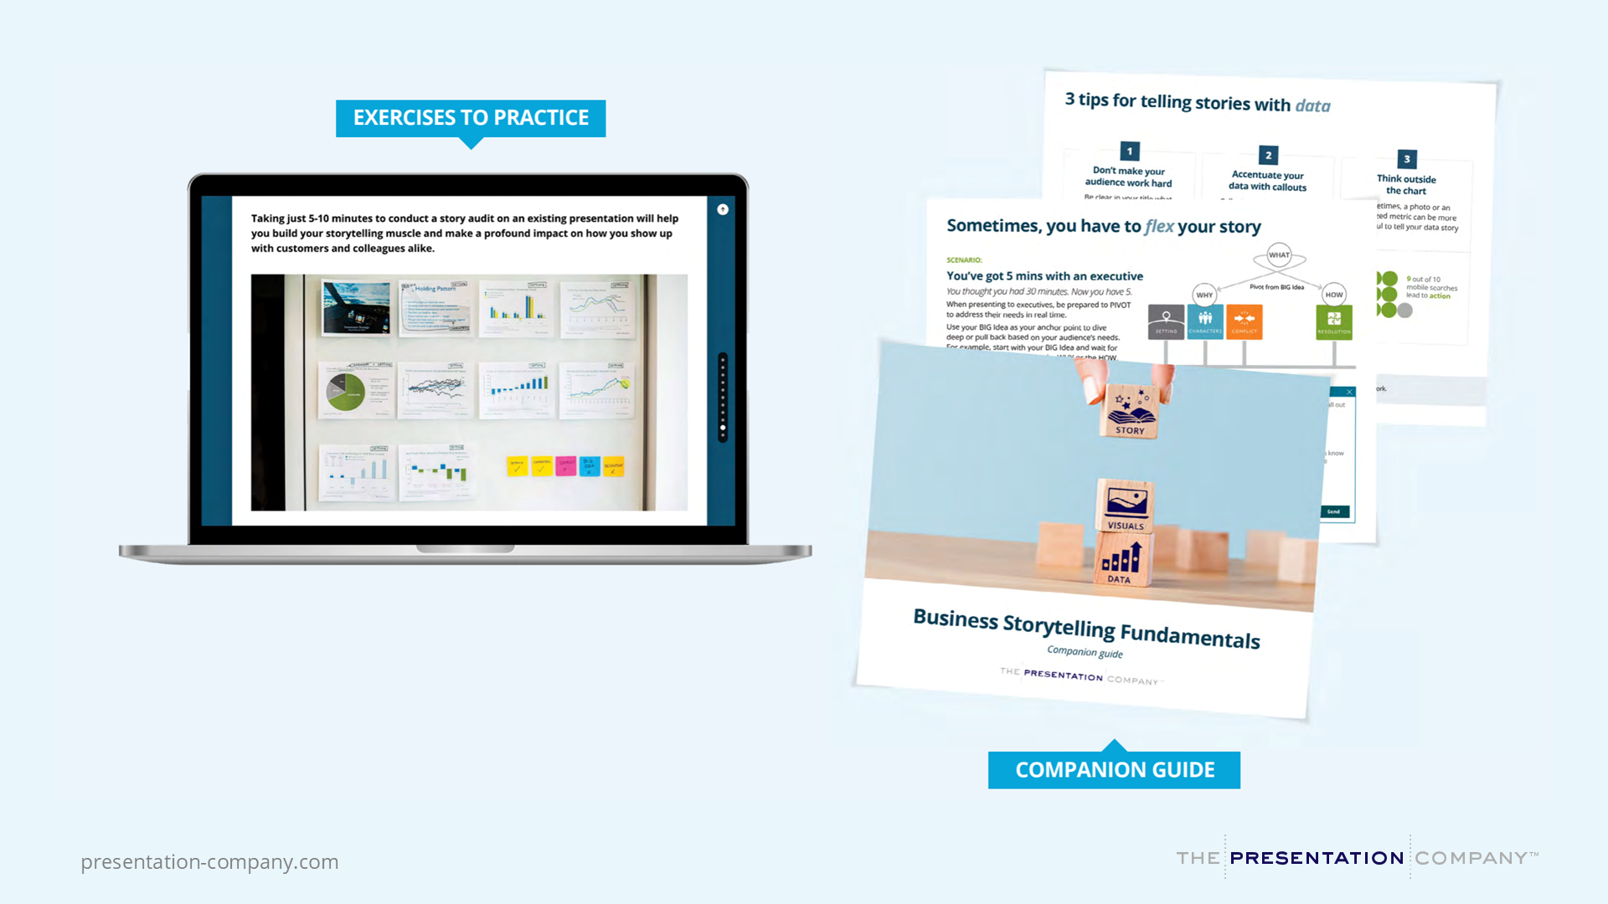
Notes:
Here’s a closer look at the Personal Action Plan, and Companion Guide to reinforce your commitments and make the best use of your time in the course.

Slide 14
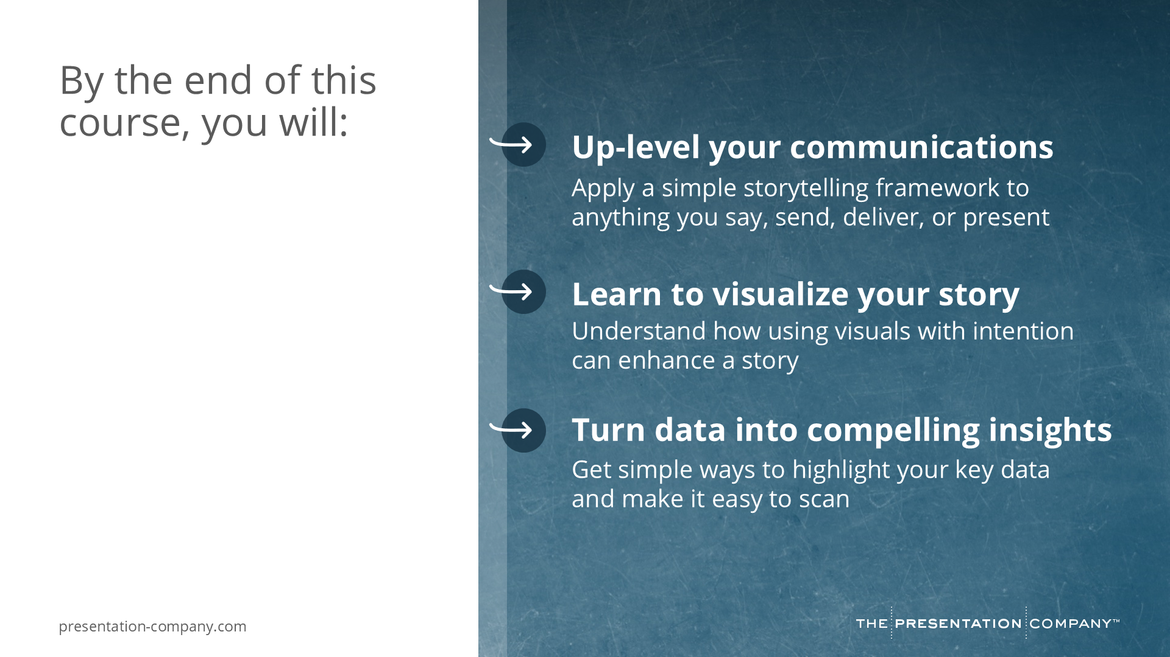
Notes:
By the end of this course, you will… [read slide]
[TRANSITION]: Now that you know what to expect, let’s talk about how to…

Slide 15
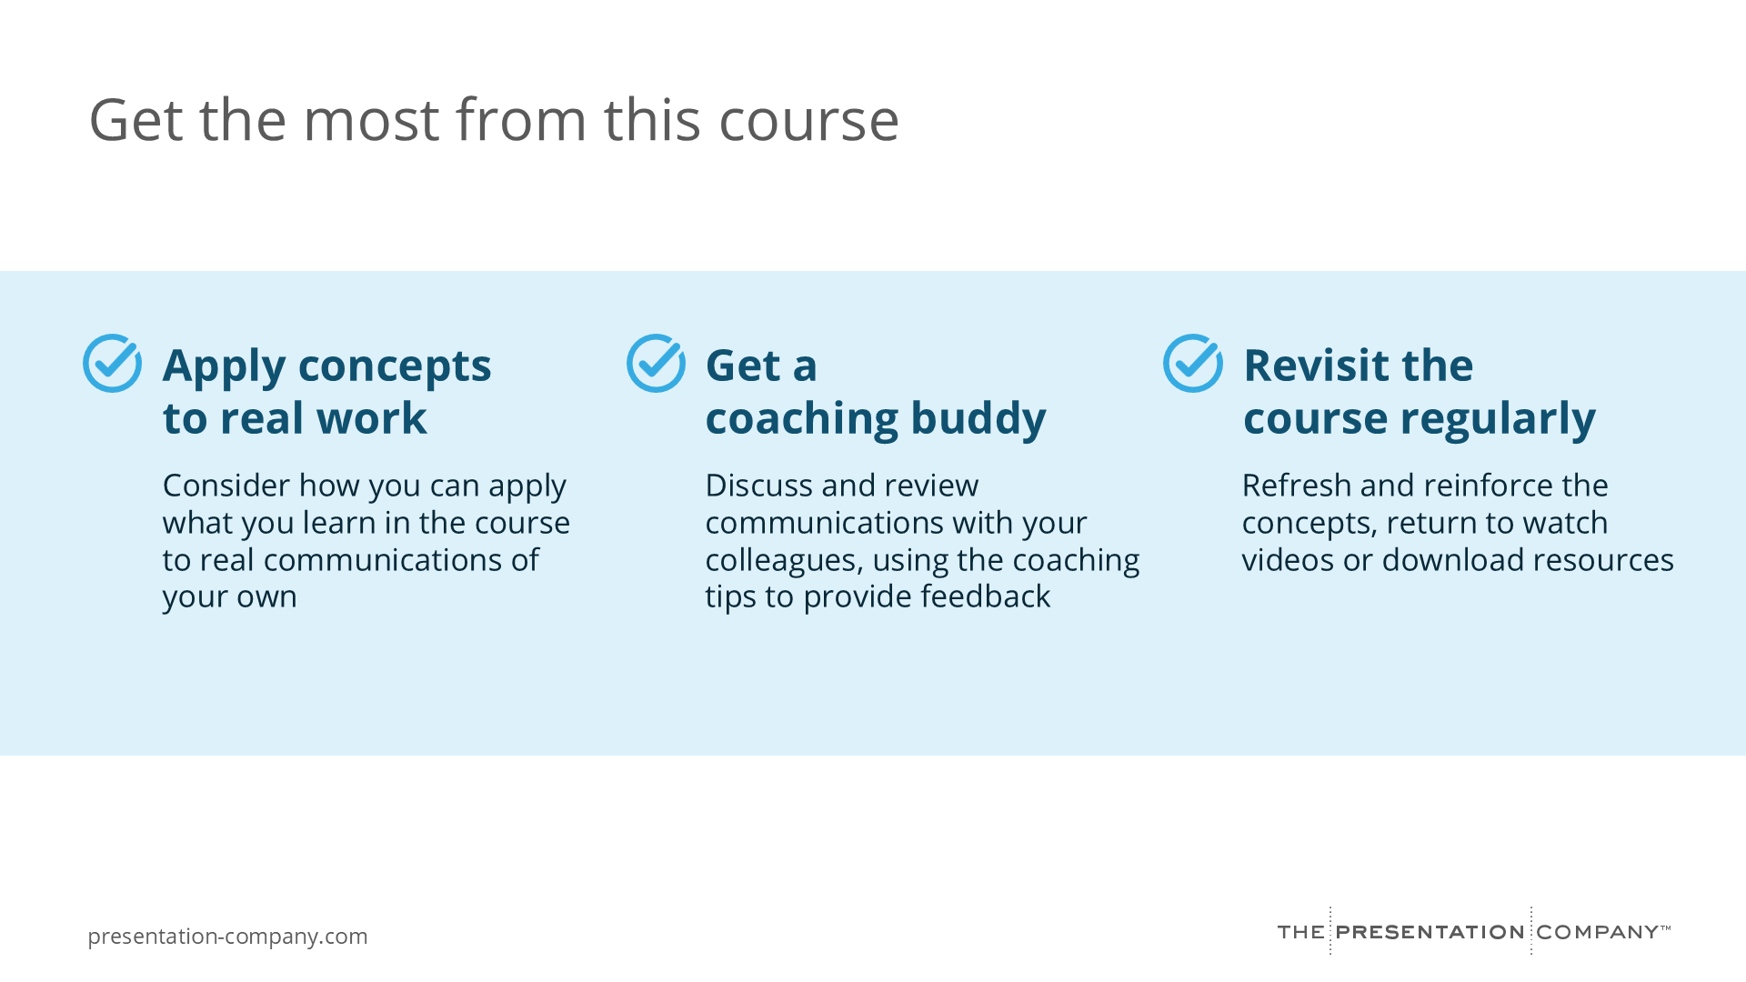
Notes:
Get the most from this course:
Apply concepts to real work:
Think about a current or upcoming communication you're working on and how the concepts can apply
Get a coaching buddy:
Hold yourself accountable by getting feedback from a colleague or friend. Discuss and review communications with your colleagues, using the coaching tips to provide feedback.
Revisit the course regularly:
Come back to the course to refresh and reinforce the concepts, rewatch videos, or download resources
[TRANSITION]: I have a call-to-action for all of you…

Slide 16
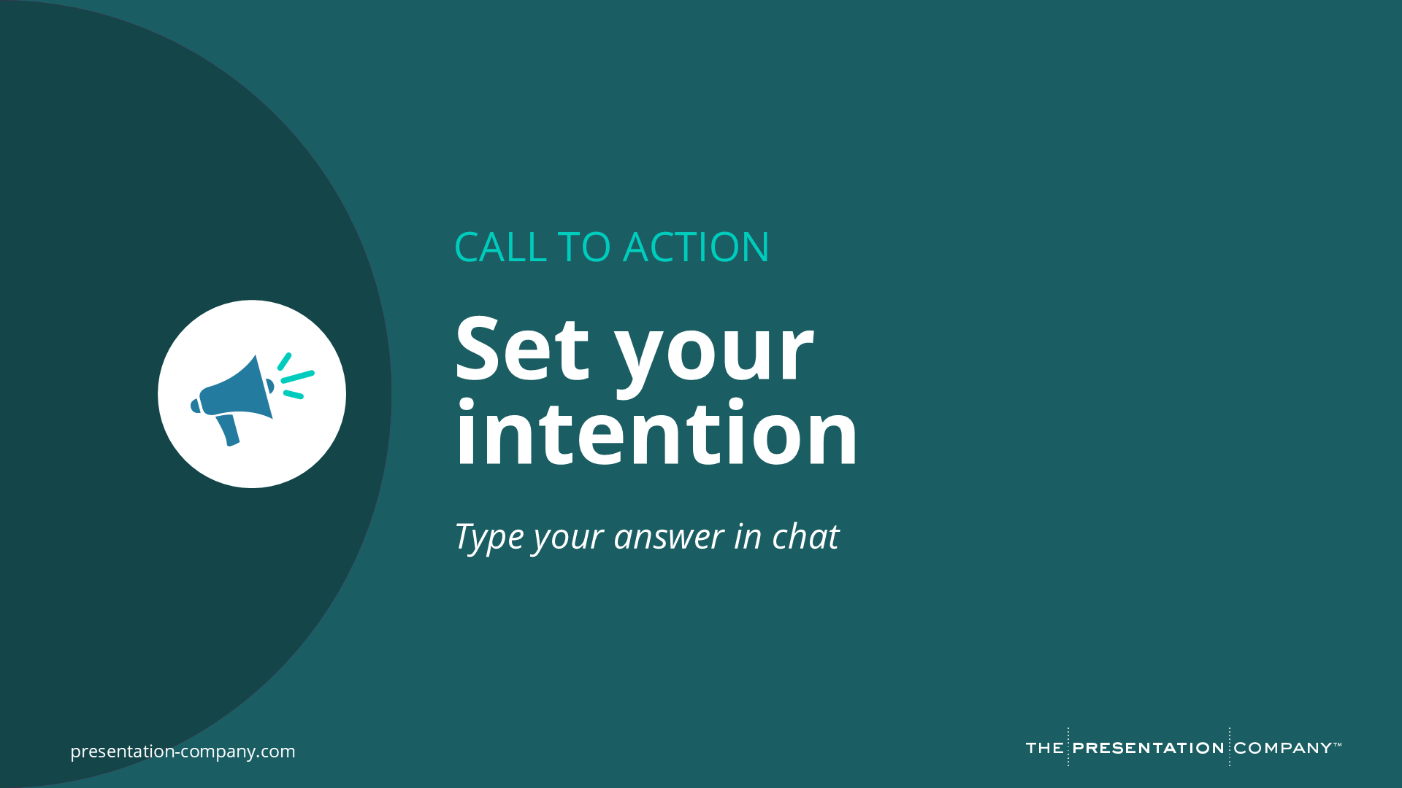
Notes:
Set your intention!
What are you ready to commit to in service of your professional development?
Maybe you want to find time in your calendar for 20 minutes per day for 3 days this week to complete the course?
Perhaps you are committing to finding a buddy to check in with over the coming month?
Maybe you’re setting a reminder to revisit the course once per month to refresh your memory?
Whatever it is, in the chat, let me know what you are committing to today.
[Read Chat responses]

Slide 17
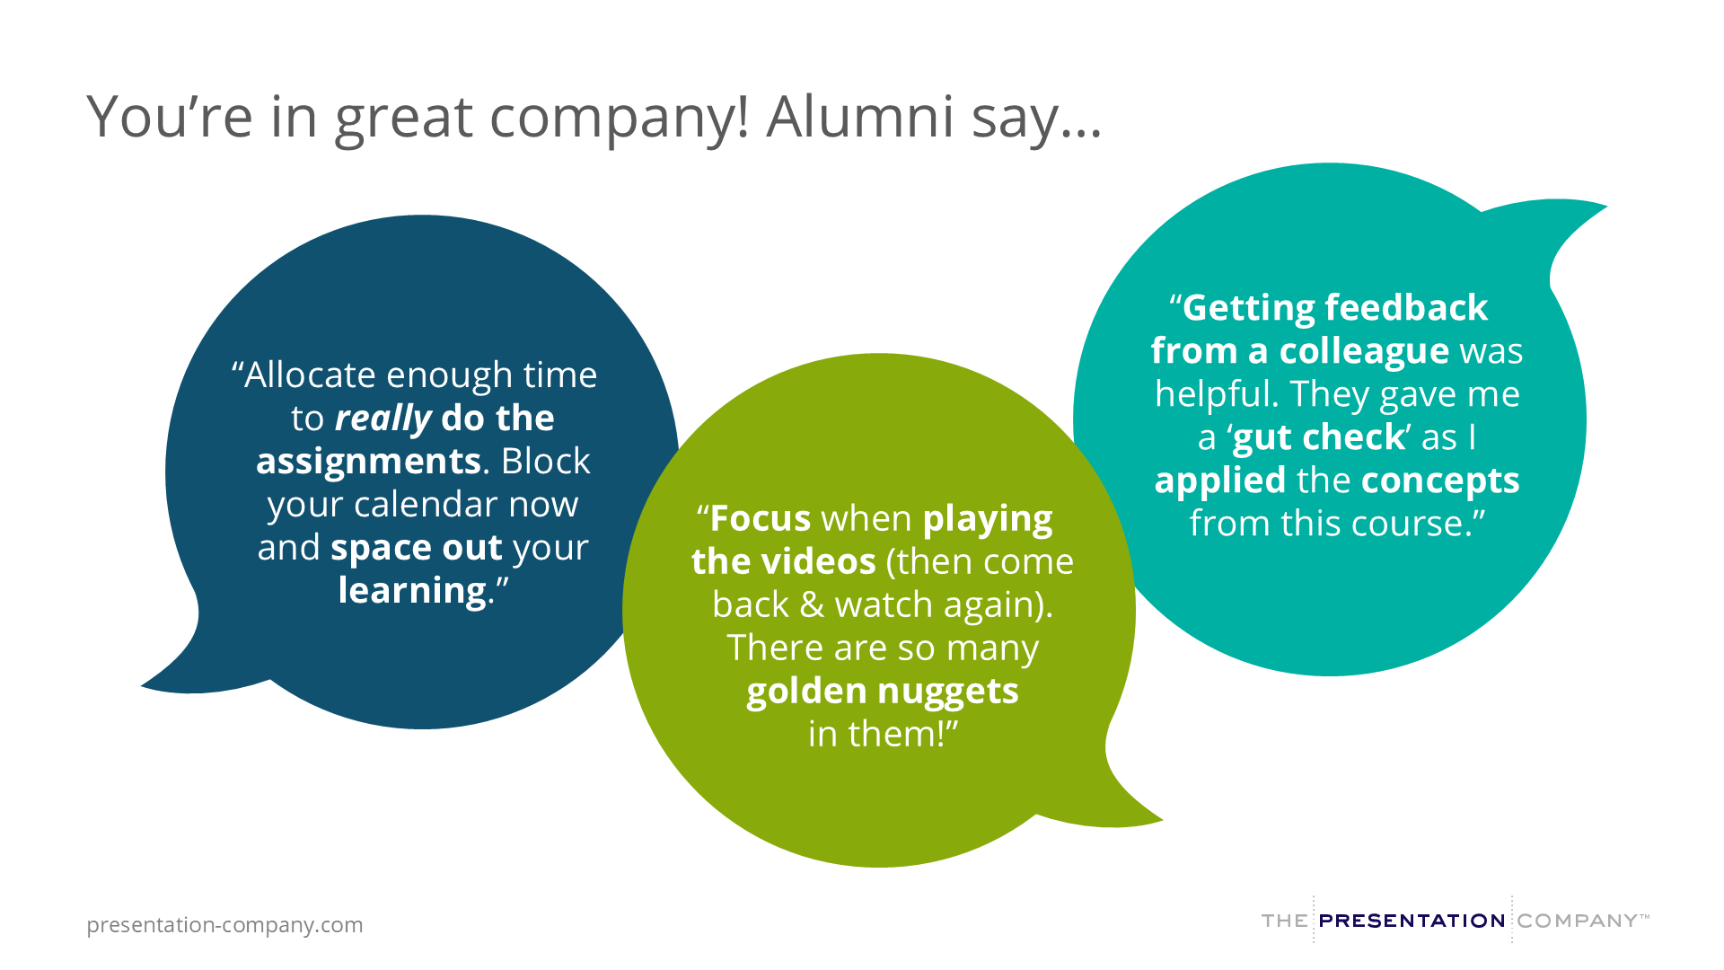
Notes:
And before we leave today, I want you to know, you’re in great company!
Here’s what alumni say when asked “What advice would you give a colleague or friend to get the most from this course?
[Read quotes on screen]
I know you’re going to love the practical concepts you get as part of this course!

Slide 18

Notes:
Thank you!
Confirm logistics:
When to start, how long it runs, how to get help
How to access the course (LMS or platform demo if needed)
Who to contact for support
Invite further questions offline

